Slide 1
Miss Frogbottom Was Wrong
10 Grammar Rules That Aren’t

Slide 2
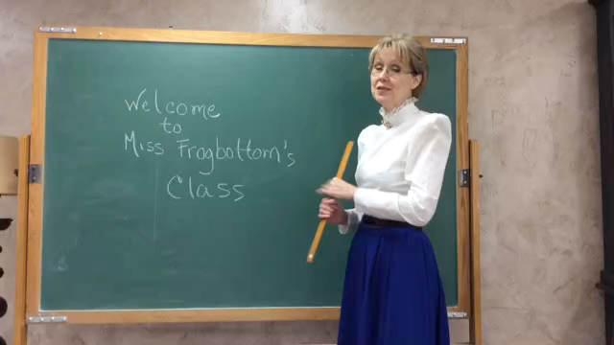
Miss Frogbottom

Slide 3
Prescriptive vs. Descriptive
Prescriptivist: A person whose approach to grammar is concerned with establishing norms of correct and incorrect use, and setting up rules based on those norms.
Descriptivist: A person whose approach to grammar is concerned with how native speakers use the language without relying on proposed rules of correctness.

Slide 4
What is Grammar?
Grammar is the set of structural rules governing clauses, phrases and words in any natural language. Style is how we choose to obey or disobey those rules.

Slide 5
Grammar vs. Style
Grammar: The doctor is in, not the doctor are in.
Style: Dr. Jones was the veterinarian at the show.

Slide 6
English doesn’t borrow from other languages. English follows other languages down dark alleys, knocks them over and rummages through their pockets for loose grammar.
-- Someone who knew what he was talking about

Slide 7
There’s changes coming.
There’s things wrong with that statement – for now.

Slide 8
So What’s Correct?
It’s still important for magazines and newspapers to use correct grammar and style
As they are understood at the time of the writing.
As they are understood at the time of the writing

Slide 9
Unbeknownst to some former editors I have had, teen-ager no longer carries a hyphen.

Slide 10
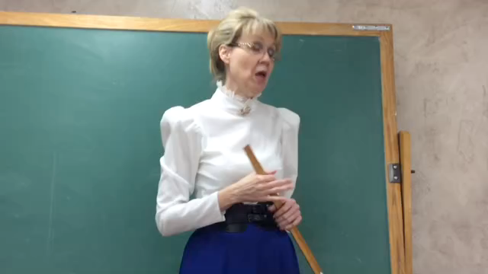

Slide 11
Which Are Correct?
Jan and I went to the beach.
I and Jan went to the beach.
Jan went to the beach with Sam and I.
Jan went to the beach with I.
Jan went to the beach with Sam and me.

Slide 12
Your Ear Knows
Jan and I went to the beach.
I and Jan went to the beach.
Jan went to the beach with Sam and I.
Jan went to the beach with I.
Jan went to the beach with Sam and me.
Notes:
Float these in one at a time.

Slide 13
Where It’s Wrong
In a direct quote in copy I received for publication:
  Between my husband and I, we make enough that I can own a horse.

Slide 14
Where It’s Wrong
On Facebook
  Two years ago today, I had the honor of having our friends and family witness Fred and I becoming husband and wife.

Slide 15
Where It’s Wrong
In an email from my sister last week
  Did you happen to get any pictures of Travis and I when we were branding?

Slide 16
How to Handle It
Don’t use “I” as the object of a preposition or a verb in your own copy.
If a source uses it incorrectly, paraphrase.
Avoid the direct quote.

Slide 17
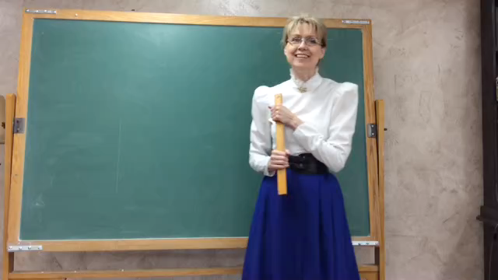
Notes:
Janet video

Slide 18
When Do You Use Which?
“Which” is for independent clauses.
“Which” is for nonessential clauses.
“That” is for dependent clauses.
“That” is for essential clauses.

Slide 19
How to Handle It
Follow the AP Stylebook

Slide 20
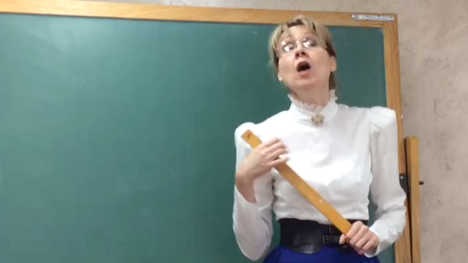

Slide 21
What the AP Stylebook Says
Who, whom
  Who is the pronoun used for references to human beings and to animals with a name. It is grammatically the subject (never the object) of a sentence, clause or phrase: The woman who rented the room left the window open. Who is there?
  Whom is used when someone is the object of a verb or preposition: The woman to whom the room was rented left the window open. Whom do you wish to see?
Notes:
Float in

Slide 22
‘That’ is not a substitute
The woman that I saw in the window was an engineer.
The woman that drove the truck was an engineer.
The woman whom I saw in the window was an engineer.
The woman who drove the truck was an engineer.

Slide 23
How To Handle It
Follow the AP Stylebook
Caveat: Many people think “whom” sounds stuck up. If your readers are among them, rewrite the sentence.
The woman to whom the room was rented left the window open.
The woman who rented the room left the window open.
Notes:
Float these in.

Slide 24
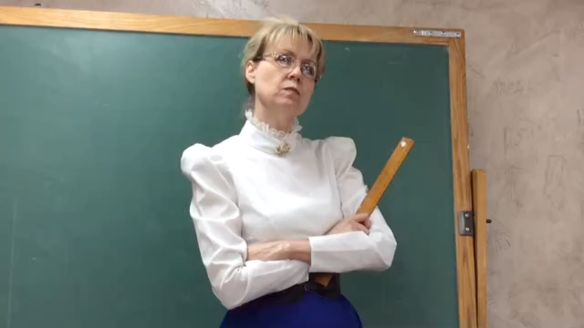

Slide 25
What the AP Stylebook Says
Google
  A trademark for a Web search engine. Google, Googling and Googled are used informally as verbs for searching for information on the Internet

Slide 26
How to Handle It
Think of the formality level of your writing.
  Are you blogging? Or writing a company’s year-end sales report?
Think of your audience.
  Are they college students? Will they feel included or excluded if you use an informal word that they might or might not recognize?
Make a decision for each piece you write.
Notes:
Float in

Slide 27
AP Stylebook Precedents
The precedent was set with the company Xerox, which is not a synonym for photocopying.
A Frisbee is a flying disc, but not all flying discs are Frisbees.
Email is still a noun only. No verbification recognized, even as informal.
  Though the spelling has changed from e-mail.

Slide 28
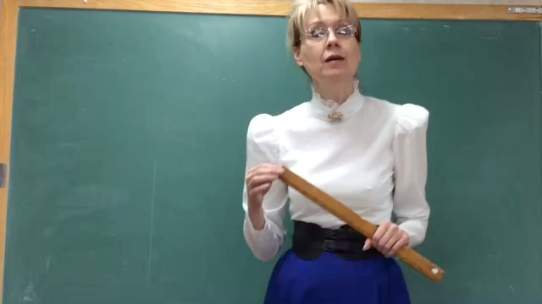

Slide 29

“You get three exclamation points in your lifetime. Do you really want to use them all up in one story?”
  Dennis Spies

Slide 30
He was mad
He was mad!

Slide 31
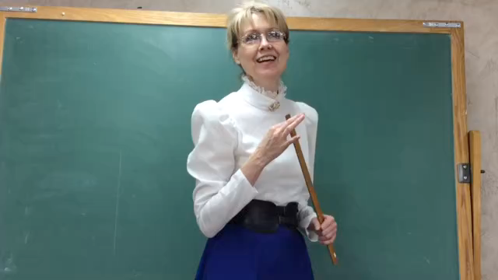

Slide 32
He was mad
He was very mad.
He was very very very mad.
Notes:
Float in

Slide 33
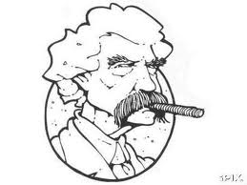
Substitute damn every time you’re inclined to write very; your editor will delete it, and the writing will be just as it should be.
  Mark Twain

Slide 34
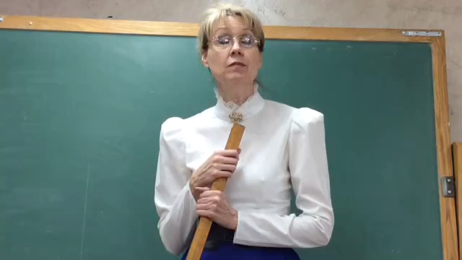
Notes:
Janet video

Slide 35

Who knows what’s wrong with this slide?
If you guess correct, I’ll give you a prize!

Slide 36
Which Is Correct?
He smiled happily
He smiled happy.

Slide 37
How to Handle It
Use a better verb that doesn’t need an adverb.
  He chortled.
Find a better descriptive phrase.
  He smiled with the joy of a man who has just seen his first child.
If you need an adverb, use it.
  He smiled happily.

Slide 38
If you answered my earlier question correctly, I have a prize for you.

Slide 39
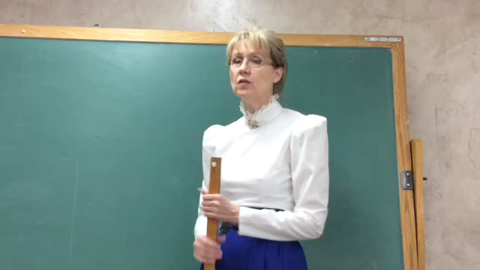

Slide 40
Someone has their knickers in a twist over grammar today.
Someone has their knickers in a twist over grammar today.
Notes:
Float in

Slide 41
How to Handle It
For now, rewrite it, changing to a plurals if necessary.
Use specific gender if needed.
  Miss Frogbottom has her knickers in a twist over grammar today.
Pay attention to shifting modes. I think this one will become standard English.

Slide 42
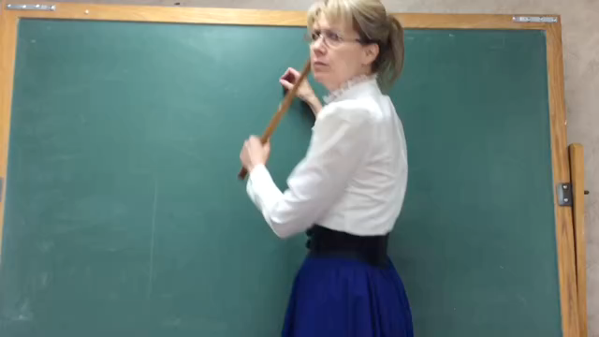

Slide 43
Non Sequitur
In Latin, it means “does not follow.”
An introductory clause must refer to the first noun of the main clause.
  By Hes Terrific and out of Miss Pawhuska, the gray mare was John’s favorite.
  By Hes Terrific and out of Miss Pawhuska, John loved his gray mare.

Slide 44
How to Handle It
Reread your copy for non sequiturs.
When you mix up your writing with introductory clauses, be sure you’re not mixing up your readers with non sequiturs.

Slide 45
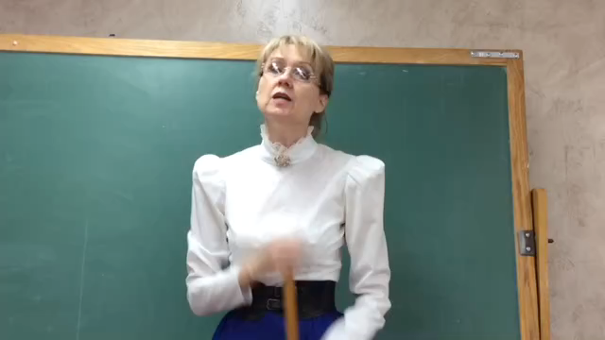

Slide 46
What the Heck is an Infinitive?
Infinitives are the “to” version of verbs
To go, to walk, to run, to drive
To stand, to sit, to kneel, to ride
To be or not to be

Slide 47

To boldly go where no one has gone before

Slide 48
How to Handle It
Split that infinitive like it’s a banana surrounding ice cream and chocolate sauce.
  Caveat: It’s more reader-friendly to keep the parts of your verb as close together as you can.

Slide 49
A Brief Overview
You and I – fix it
That/which – learn it and fix it
Who/whom – learn it and rewrite it
Verbification – think of your readers
Exclamation point – delete it
Very – delete it
Adverbs – use them
Non sequiturs – fix them
Split infinitives – split and go

Slide 50
Resources
The Associated Press Stylebook
  A new edition will be released July 14. Mine is on preorder. Is yours?
“On Writing Well”
  by William Zinsser
“Do You Speak American”
  by Robert MacNeil and William Cran

Slide 51
Many Thanks to
The estimable Miss Janet Whitsell
  as Miss Frogbottom
Mrs. Kendrick
  Sunset Elementary School
Mrs. Napp
  Sunset Elementary School

Slide 52
Many More Thanks To
Janey Joyce, Amarillo Globe-News
Dennis Spies, Amarillo Globe-News
Bruce Beck, Amarillo Globe-News
All my current and former colleagues who love grammar and arguing in equal proportion

Slide 53
But the Most Thanks
Go to you.
Thanks for listening.
You’re awesome.

